Slide 1
Trie Data Structure
Datová Struktura Trie
Author: Tuan Phong HUYNH
Supervisor: Prof. Ing. Michal Krátký, Ph.D.
Year: 2025

Slide 2
Known as a digital tree or prefix tree.
Used in autocomplete, spell-checking…
Searching time proportional to word length, not data size.
Challenging to implement efficiently for large alphabets (Unicode)
Introduction –
What is a Trie?

Slide 3
Analyze and compare different Trie data structures:
Unsorted Trie
Sorted Trie using Binary Search
Hash Table Trie using Linear Probing
Focus on performance of 3 basic operations with large alphabet:
Insert
Search
Delete
Compare results with:
Sequential Array
Compressed Trie
Hash Table Trie using Quadratic Probing
Objective of the Thesis
Notes:
In this section, the comparison of different trie data structures focuses on how the nodes are implemented—whether using unsorted arrays, sorted arrays, hash tables, or sequential structures

Slide 4
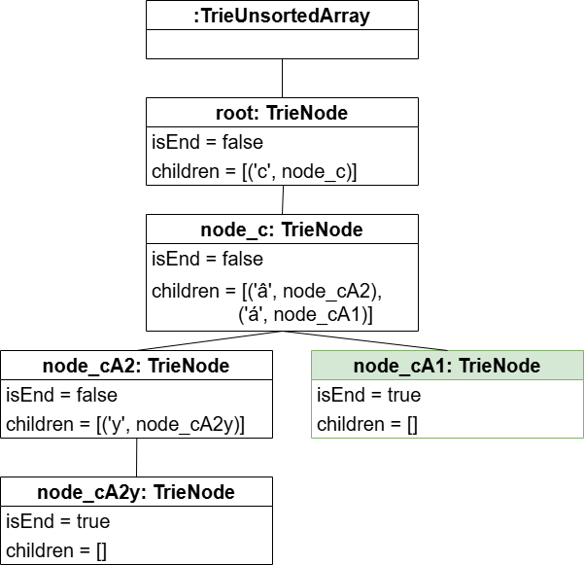
Node implementation:
unsorted Array
|𝐶|: The actual number of children in a node
Insert: O(|𝐶|)
Search: O(|𝐶|)
Delete: O(|𝐶|)

Slide 5
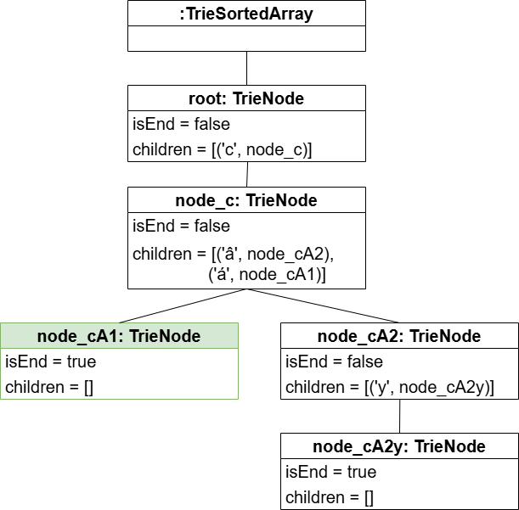
Node implementation: sorted Array
|𝐶|: The actual number of children in a node
Insert: O(|𝐶|) → O(log|𝐶|)
Search: O(log|𝐶|)
Delete: O(log|𝐶|)

Slide 6
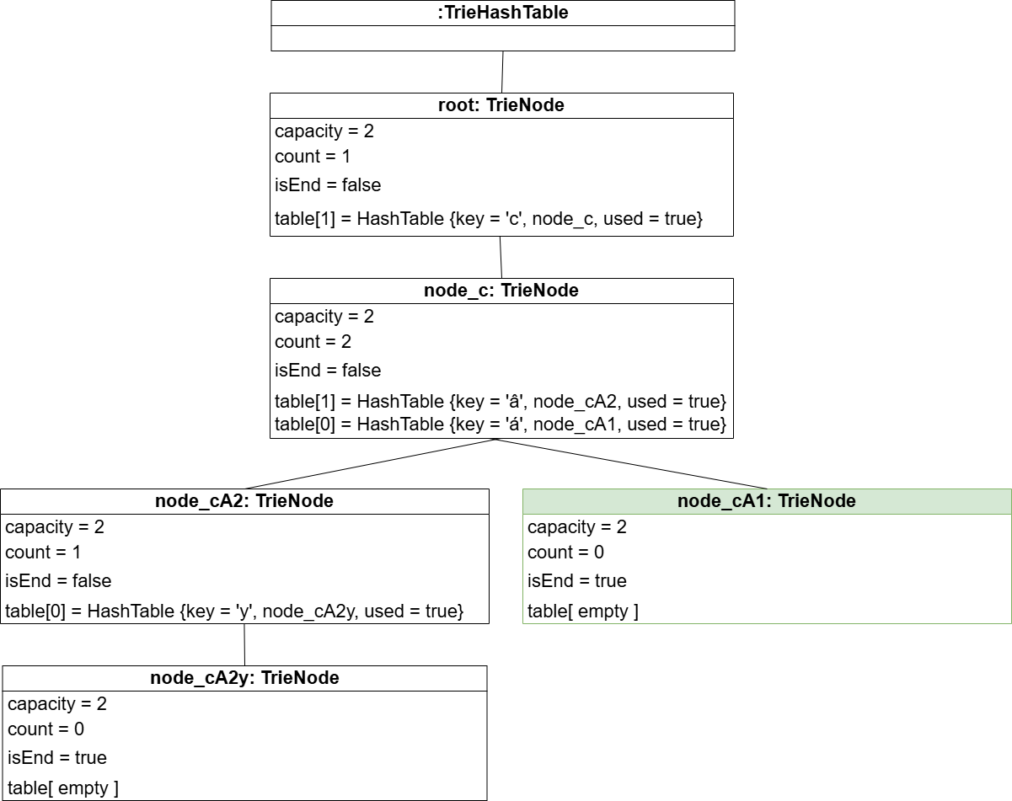
Node implementation: Hash Table
|𝐶|: The actual number of children in a node
Insert: O(1)
Worse case: O(|𝐶|)
Search: O(1)
Delete: O(1)

Slide 7
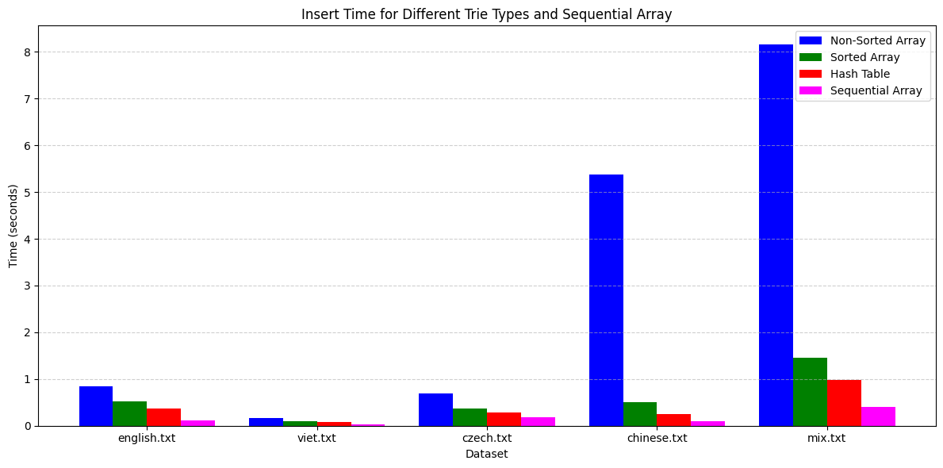
Experiment: Insert – Time

Slide 8
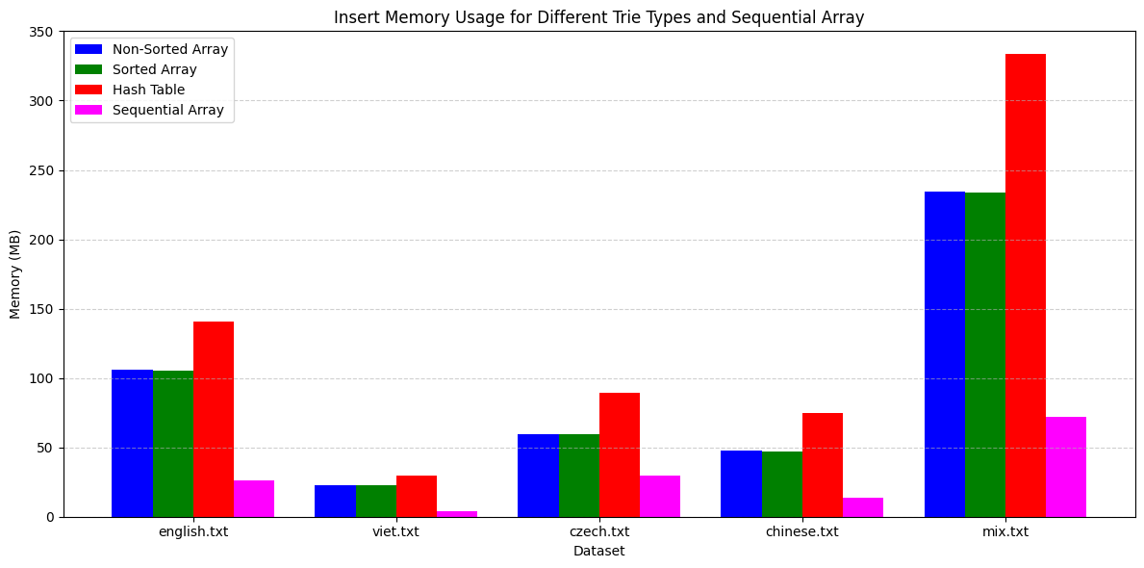
Experiment: Insert – Memory

Slide 9
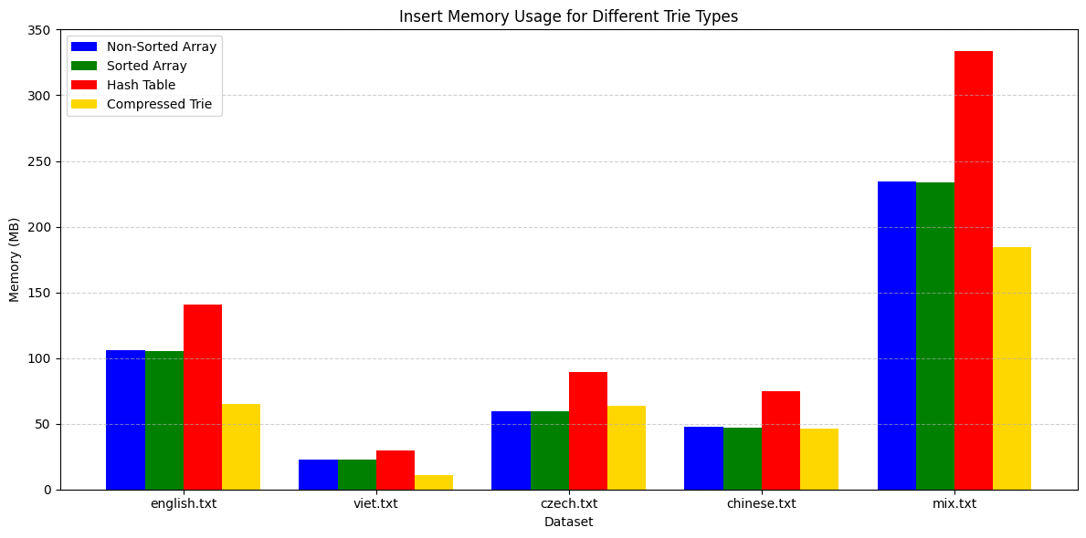
Experiment: Insert of Compressed Trie – Memory

Slide 10
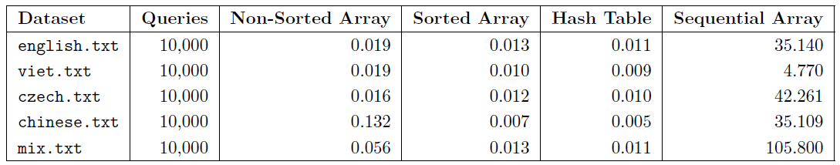
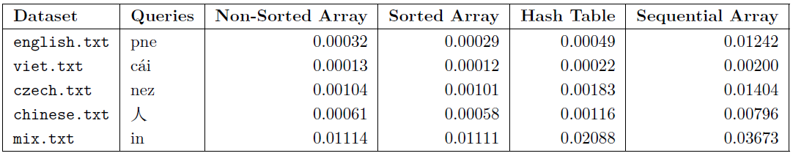
Experiment: Search – Time

Slide 11
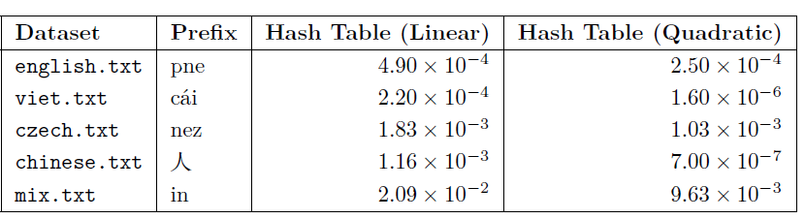
Experiment: Search of Linear Probing and Quadratic Probing – Time

Slide 12
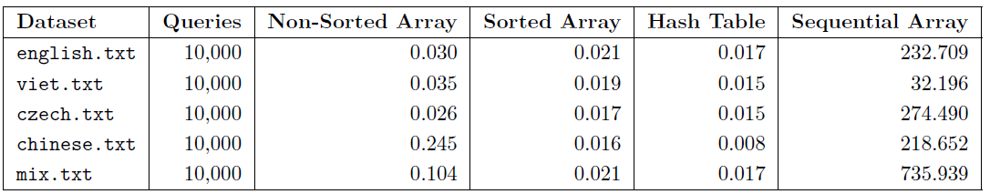
Experiment: Delete – Time

Slide 13
Hash Table Trie is fastest → uses more memory
Sequential Array saves space → slow
Sorted Array offers a good balance of speed and memory.
Unsorted Array is simple to implement → Less effiency for large alphabets.
Trie is confirmed as an efficient structure for string processing
Conclusion
Notes:
Depending on requirements such as speed or memory different trie implementations can be chosen to get the most optimal performance.

Slide 14
Thank You

Slide 15
Defense Answers
Encoding of unicode characters in nodes is not clear. Perhaps, it can be hidden using codecvt, but it is rather important to get the optimal size of the Trie. Is it encoded using the fixed-size, 4B, values? Or using the variable-size, 1-4B, values?
Fixed-size encoding: 4 bytes → good for using variable length code in future works
Why the number of nodes with 0 children dominate in the case of Czech and Chinese, whereas it is 1 for Vietnamese and English (see page 33)?
Datasets contain many unique and short words:
Chinese – single word is a full word, Czech – many short variants for a word
English – Vietnamese: long prefixes
It is not clear why the results of Non-sorted array are always worst although you show that the majority of nodes includes only one value (see page 33).
Small nodes with a large number of children (|𝐶| >> 1) – near root
Definitely appear in search → Linearly search → making results worst
Sorted Array (binary search) and Hash Table (hash function) → index → directly access
Notes:
Each character in my trie is stored as a wchar_t, which means every character takes a fixed amount memory 4B. good for using variable length codes in future works.
In Chinese, a single character can be a full word, in Czech there are many variant for a word. For example: 人 in Chinese and (domu - domy) in Czech -> it will make the trie create a new node after go through a few characters (1-2 characters). As a result, the branch is eneded quickly, forming short path like this will cause a high number of nodes with 0 childrens. On the other hand, English and Vietnamese words have a lot of long prefix words like playing – playground, these words are sharing long common prefixes. Making branches have long deep paths, as a result, it causes a lot of nodes with 1 child.
It is true that most nodes have only one child. However, the unsorted array trie performs the worst because of a small number of nodes with a large number of children. These nodes usually appear near the root or within shared prefixes, so they are accessed frequently during operations. In unsorted trie, linear search is used, so it must scan through all children in those few high-|C| nodes before reaching the isolated branches. As a result, it makes the result worst. On the other hand, Sorted trie and Hash table Trie use binary search and hash function to return the index to access directly.

Slide 16
Defense Answers (cont.)
In the case of the Sorted array node, you propose 0.013s for 10 000 queries over the mix data collection, in the case of the Sequential array it is 105.8s. It is not clear why it is 0.011 and 0.036 for prefix searching, i.e. the Sorted array node is only 3x faster?
Because prefix search different from a whole string search: A whole string – following 1 path. Prefix search – traverse all words under that node → recursive traversal a lots.
Recursive same for all. Advantage of binary search is less for searching 1-2 nodes. Sequential array: check prefix – add into array – move to next string.
Can you compare your work with the article from the assignment: "Aoe, J.-I., Morimoto, K. and Sato, T. (1992), An efficient implementation of trie structures. Softw: Pract. Exper., 22: 695-721. https://doi.org/10.1002/spe.4380220902"?
Article work: Double-array, tail compression, fast access, memory efficiency, ASCII only.
My work: Array with pair <character, node>, various structures, not memory effciency, Unicode.
Would it be possible to avoid the result materialization in the prefix searching using an iterator?
Iterator for searching prefix: save memory, slowdown searching, good for searching few first strings.
Notes:
Because prefix search different from a whole string search.
In a whole string search, it traverses to the end of the word by following 1 path. So the speed is based on how fast that the algorithm can access a character. That’s why binary search O(log|𝐶|) outperformance linear search O(|𝐶|) .
But in prefix search, once the prefix is matched, the algorithm has to traverse all words under that node. That means it can do recursive traversal for hundred of words.
All trie structures use recursion to search for a prefix. So most of the time is spent traversing the subtree, not on binary or linear search. Which means the advantage of binary search will be reduced because it only searched in 1-2 nodes. Meanwhile in sequential array, it will only check for the prefix and add the whole string into the result array and move to the next string. That’s why the speed is only faster 3 times.
Compare my work with article work:
Article work: using double array
Base for mapping to index of its children (for example: BASE[4] => if it negative there is the end of a word)
Check for checking parent of a child node, if check is positive, means it links to a node, else, it is the position of the end of a word in Tail array
Tail array: holding all the entire suffix string using tail compression technique.
This structure access very fast O(1) per character and memory efficiency
Designed for ASCII
My work:
Using dynamic array with pair character – node, each node will have a flag isEnd and a array to point to children nodes.
Implement various data structures unsorted, sorted, hash table. With fastest access is hash table with time complexity is O(1). However, in my work still does not optimal the memory efficency,.
Designed for large alphabets Unicode included.
Yes, we can use an iterator for searching prefix, this solution will save memory however it will slowdown the searching. For example, if we use an iterator to find the 1000th word that has the prefix we want, it has to go through all 999 previous strings. In my current implementation, it allows me to get all the strings that matches the prefix, then we can filter or or sort the result. To conclude, if we want to doing autocomplete for searching few first strings matches the prefix, iterator is okay to use, if we want to display all results or juml to N-th result, materialization is better,

